Slide 1
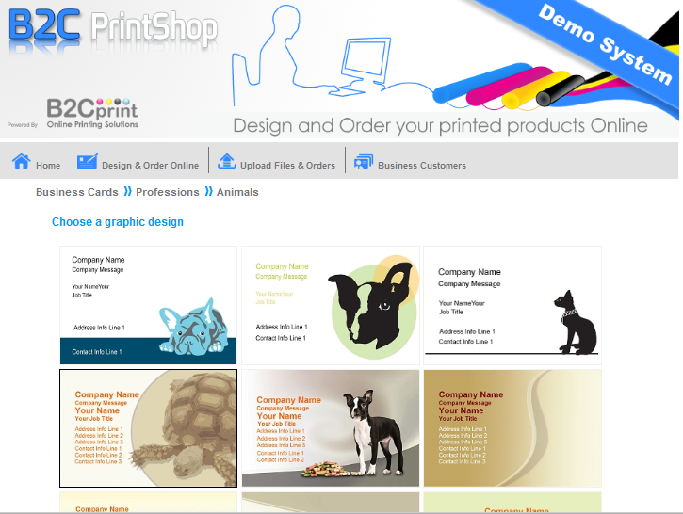
End user can select from over 3000 templates

Slide 2
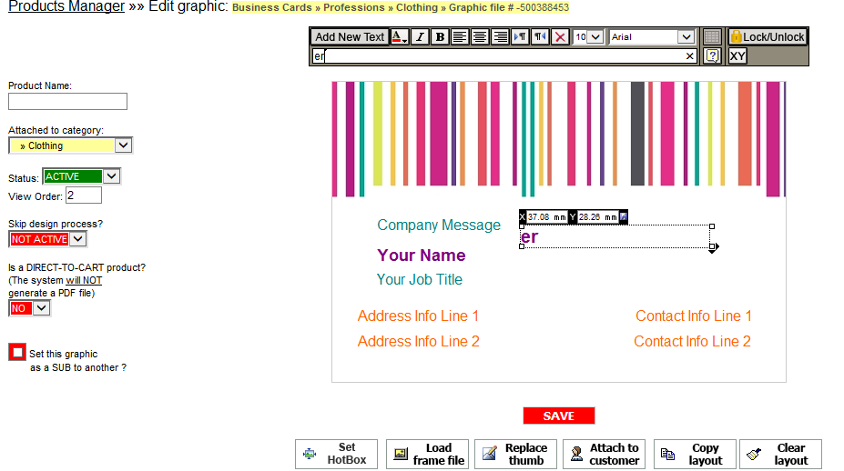
Create new templates and attach them to your members via Management system

Slide 3
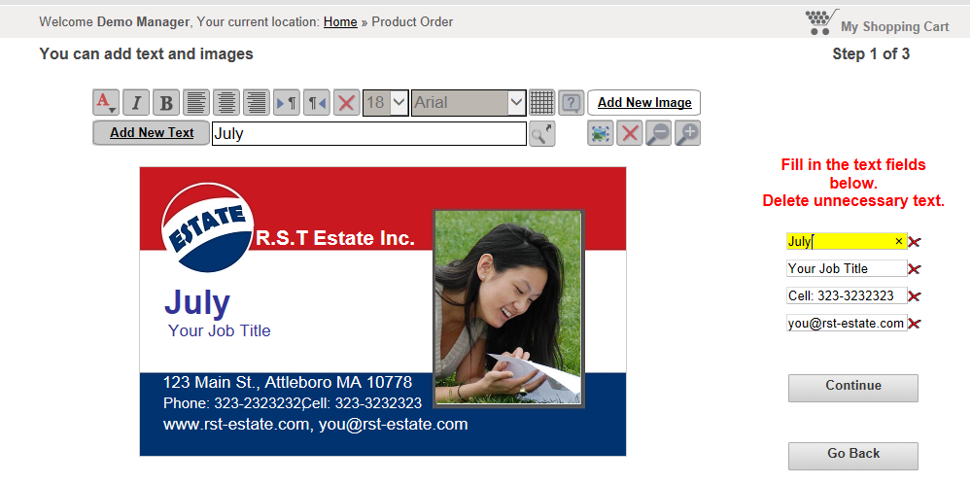
End user can add his image to the product

Slide 4
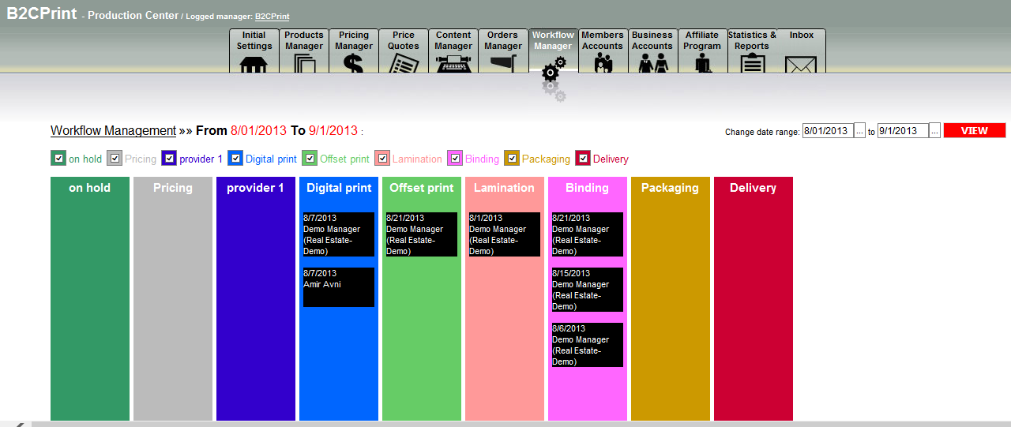
your staff can streamline jobs into the system with the job details, price etc. and define the statuses that the job has to go thru, Print provider can open this workflow to all his employees

Slide 5
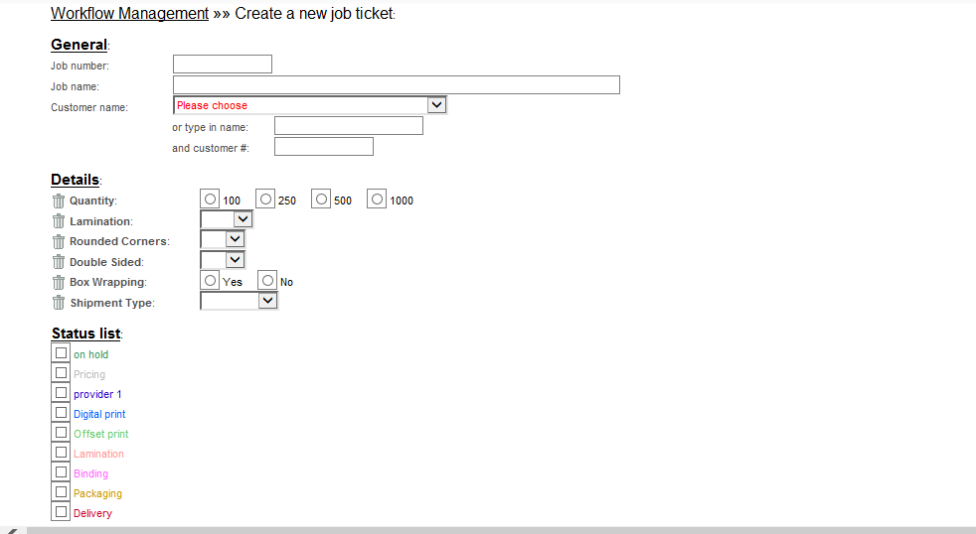
Print provider or his crew can generate a job ticket and place it on the workflow for the staff to continue the process

Slide 6
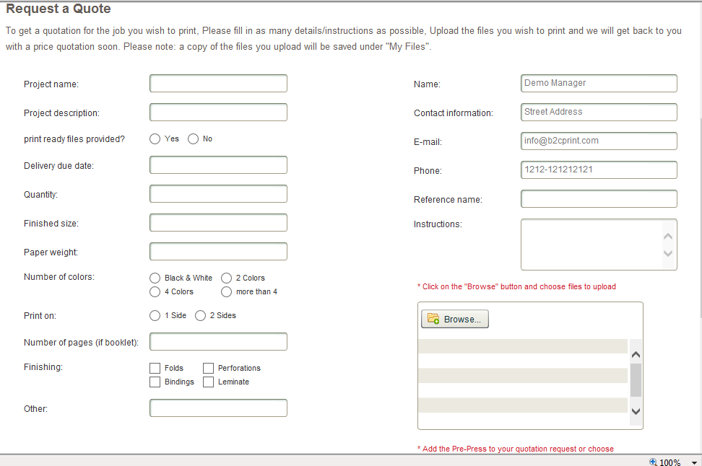
Requesting a quote that requires an approval

Slide 7
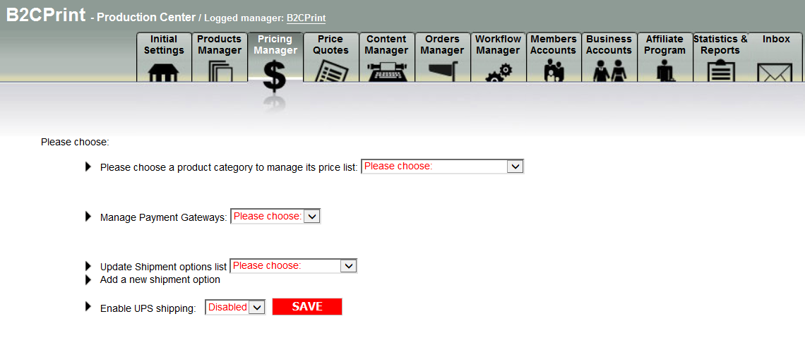

Slide 8
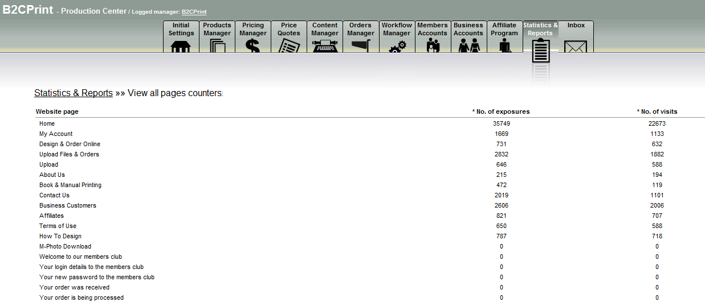
At the management system – P.P can check how many customers enter each one of his content pages , most profitable product and he can also connect to google analytics

Slide 9
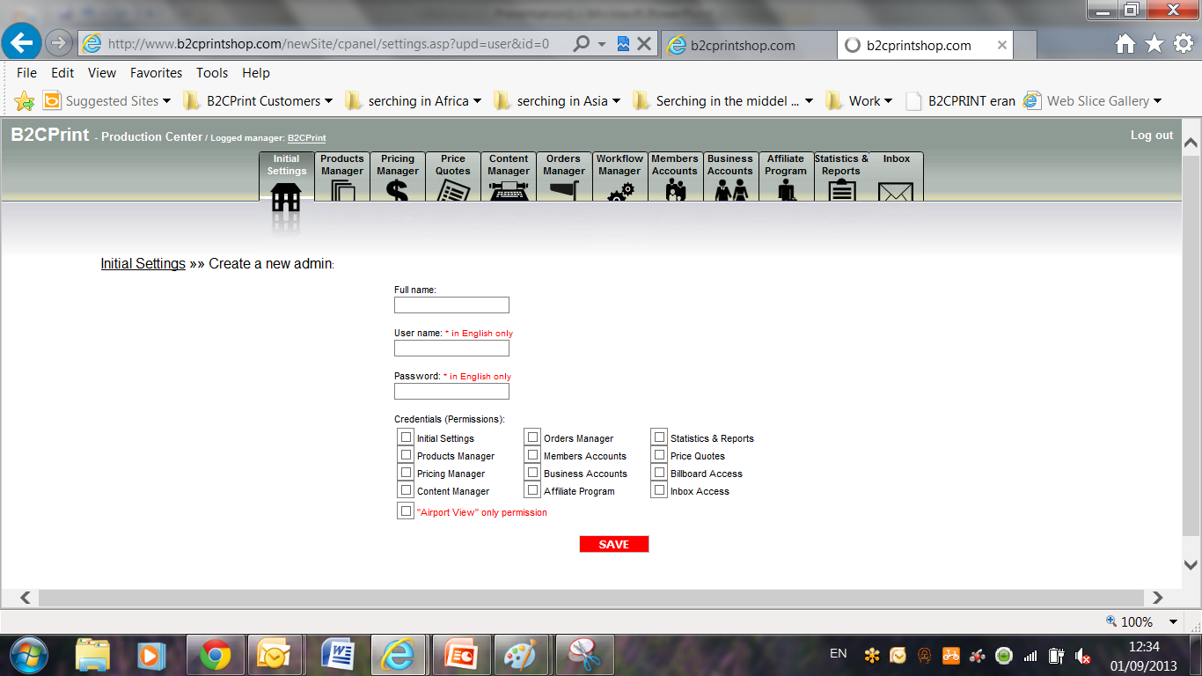
Create administrators and allow them different permissions to use the management tool, including the workflow manger (air port view)

Slide 10
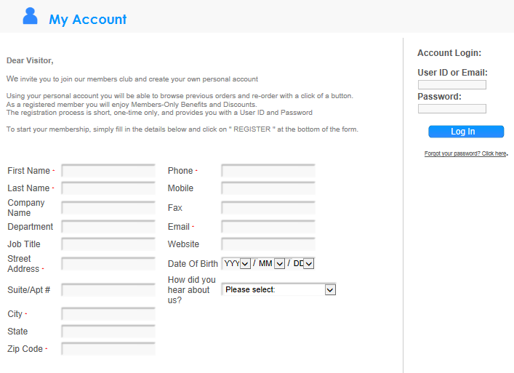
User will Enter his details and open his personal account

Slide 11
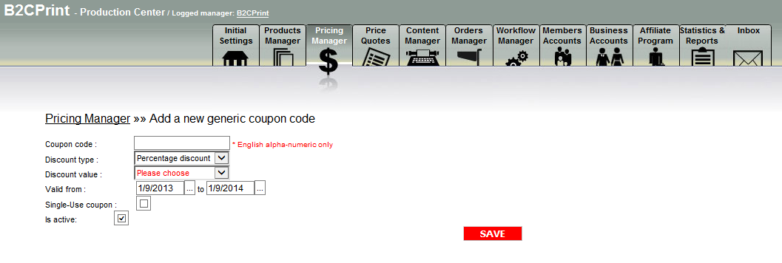
Generate coupons that can be displayed either on the shopping cart for the end users usage or distribute in places with a lot of traffic

